Slide 1
Second Suomi NPP Applications Workshop
Sundar A. Christopher
Dean, College of Science
Professor, Department of Atmospheric Science
The University of Alabama in Huntsville
sundar@nsstc.uah.edu

Slide 2
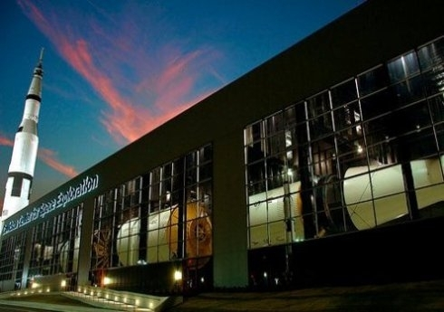
Welcome to Huntsville, AL
Huntsville Metropolitan Area : 500K
Cummings Research Park is the second largest in the nation – 4000 acres, 25000 employees
Redstone Arsenal

Slide 3
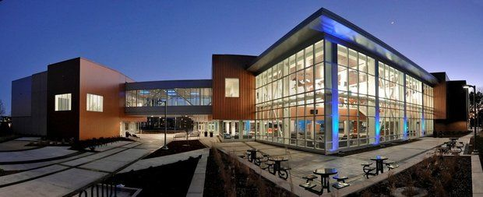
The University of Alabama in Huntsville
7500 students
Tier 1 University
4 Programs in NSF Top Ten : $100M Research
Engineering, Science, Business, Liberal Arts, Nursing and now Education, Honors Colleges

Slide 4
UAH Strategic Plan
Partnerships
Aerospace and Systems Engineering
Biotechnology
Cybersecurity and Big Data
Earth, Atmospheric, and Space Science and
Gaming and Entertainment Arts
NASA
NOAA
UAH
Research
Park
National/
International

Slide 5
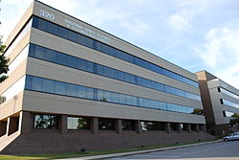
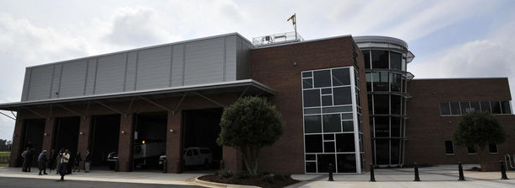
NSSTC
Vibrant NASA, NOAA, UAH collaborations
Top ten Atmospheric Science Department
A new program in Space Science
SWIRLL
Severe Weather Institute for Radar and Lightning Lab

Slide 6
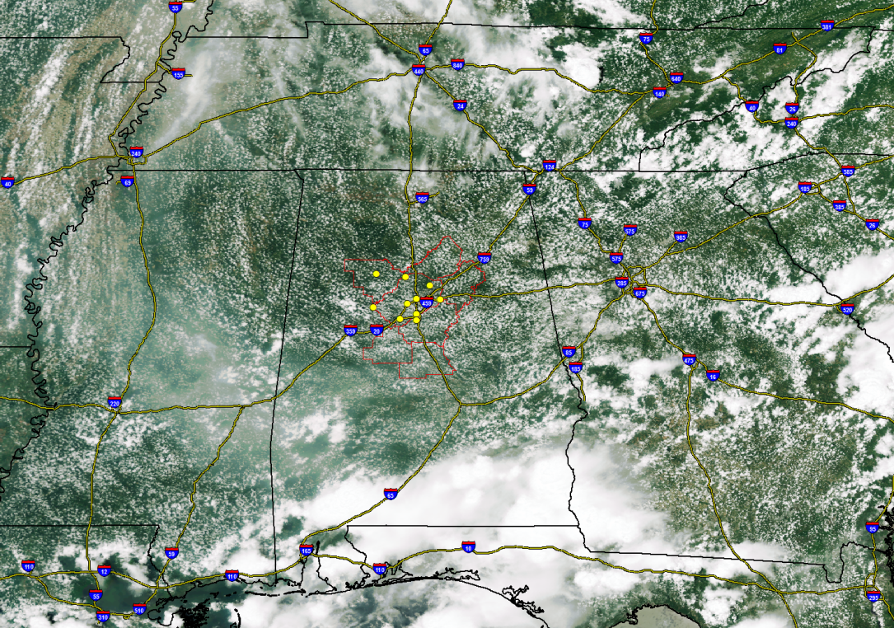
NPP Research
Excellent NPP Work at NSSTC – Aerosol, Air Quality, Public Health, Climate, Disasters, Ecological Forecasting, Weather, Climate, Data Systems
Aerosol
Birmingham
Alabama

Slide 7
Summary
Again, Welcome to Huntsville and please make sure that you experience Alabama Hospitality and of course world famous BBQ!

Slide 8
Back Up Slides

Slide 9
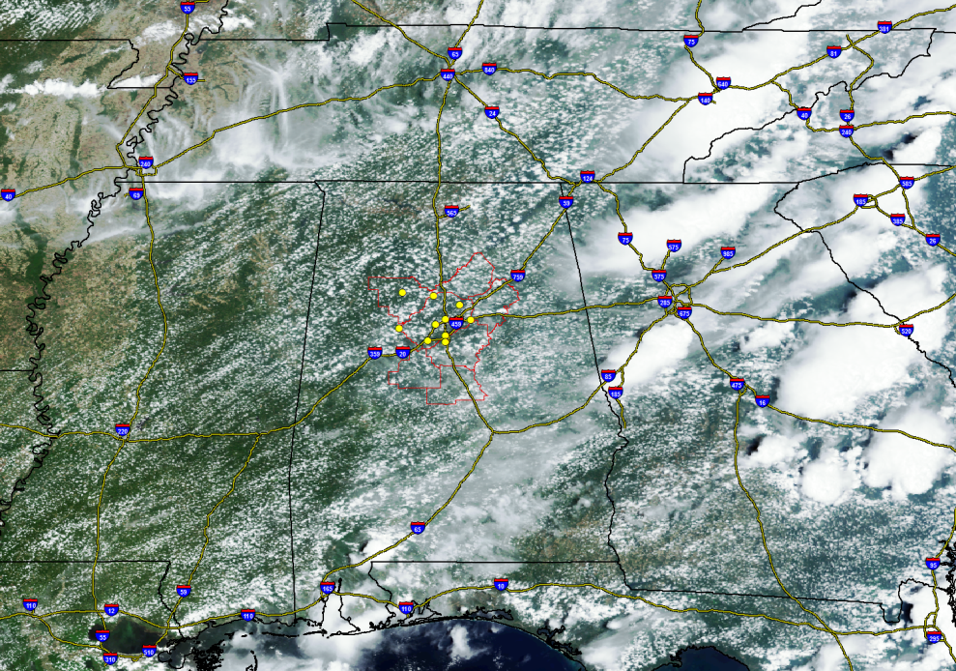
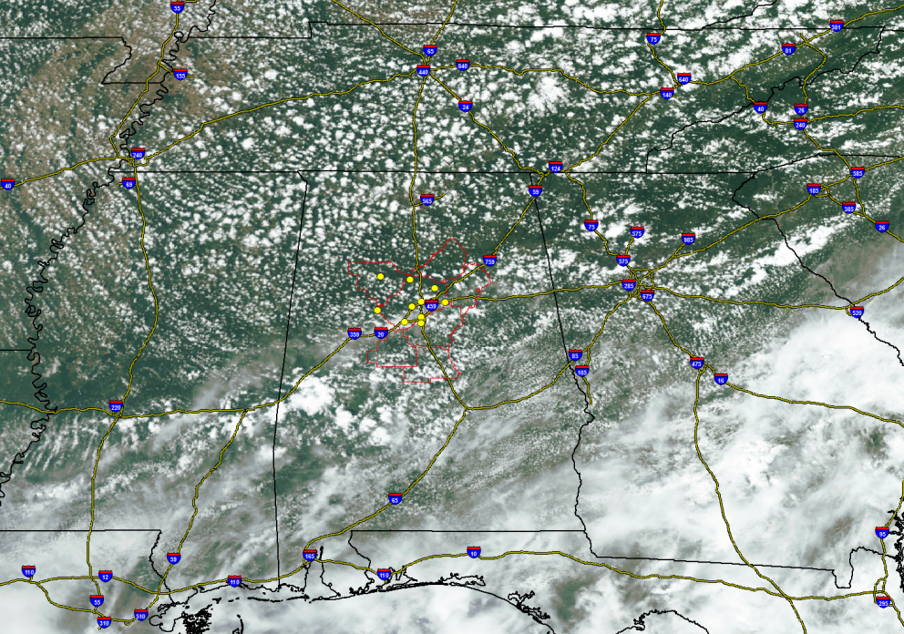
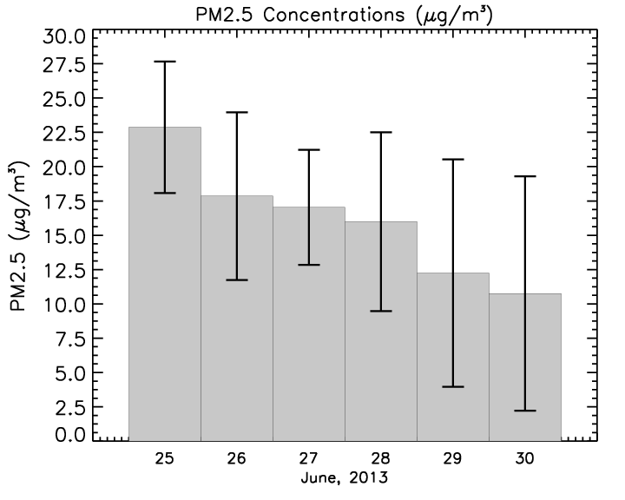
VIIRS Examples
June 23, 2013
June 26, 2013
June 29, 2013

